Slide 1


Design of an Isolated Power Supply for Cell Phone Charging
Justin Alam, Saif Elsaady
Arizona State University

Slide 2
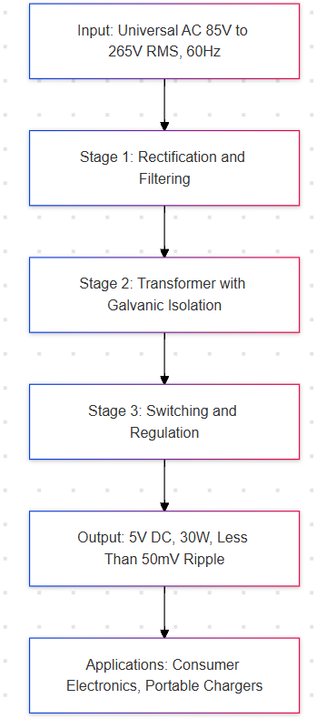
Abstract & Project Scope
Objective: Design a 5V, 30W isolated power supply with universal AC input (85V–265V RMS).
Topology: Flyback converter for simplicity, cost, and performance.
Key Metrics: 75.65% efficiency, <50mV ripple, stable operation across input ranges.
Tools Used: Texas Instruments Power Stage Designer, MATLAB.
Key Requirements:
Input: Universal AC (85V–265V RMS, 60Hz).
Output: 5V DC, 30W with galvanic isolation.
Ripple Voltage: Less than 50 mV.
Applications:
Consumer electronics and portable chargers.

Slide 3
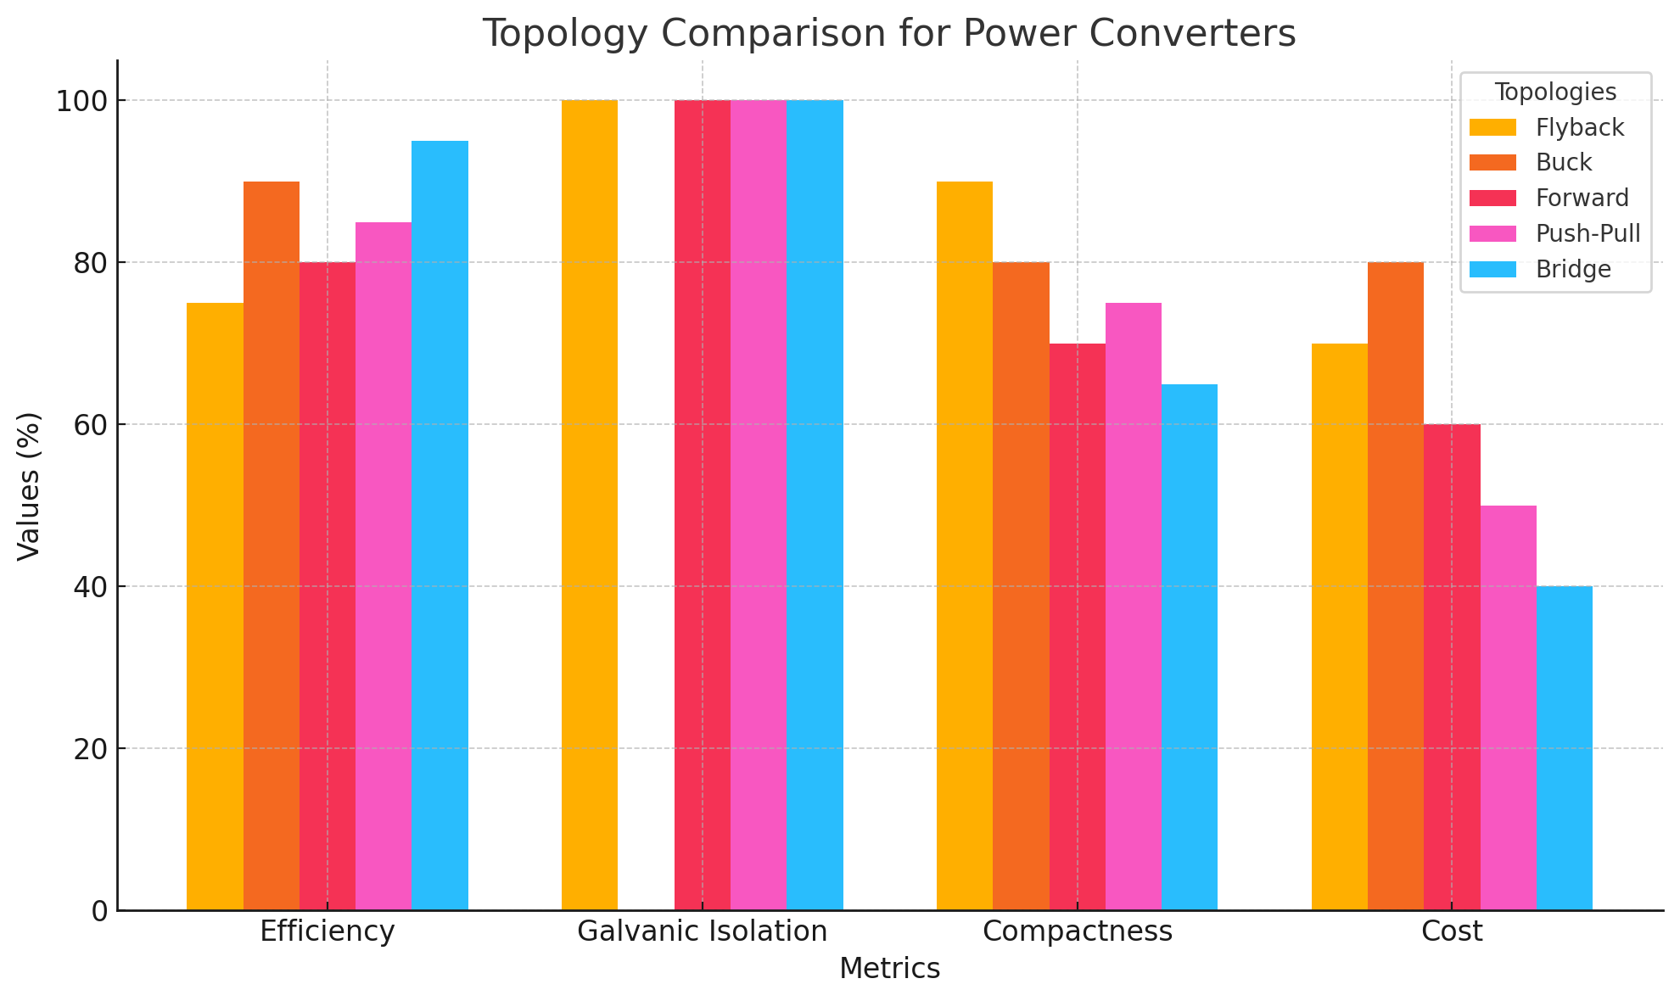
Topology Selection
Flyback Converter
Why?
Efficiency for low power (<100W).
Galvanic isolation via transformer.
Compact and cost-effective.
Alternatives: Buck, Forward, Push-Pull, and Bridge converters (with limitations).

Slide 4
Circuit Design
AC to DC Conversion:
A bridge rectifier (four diodes) converts the universal AC input (85V–265V RMS) into pulsating DC.
An input capacitor (470 μF, 400V) smooths the rectified voltage and reduces ripple.
This provides a stable DC input for the primary side of the transformer.
Transformer and Storage:
Custom transformer with a 40:1 turns ratio and 34,000 μH inductance.
Provides galvanic isolation between the input and output for user safety.
Stores energy in the magnetic core during the "on" phase of the MOSFET.
Switching and Transfer:
MOSFET (650V, 10A, RDS(on)=37mΩ) controlled via pulse-width modulation (PWM).
A snubber circuit (100Ω resistor, 10nF capacitor) dampens voltage spikes caused by transformer leakage inductance.
Output Rectification and Filtering:
A Schottky diode (200V, 6A) rectifies the transformer’s secondary voltage.
The output capacitor (1000 μF, 10V, low ESR) reduces ripple voltage to <50mV.
Feedback Loop:
Monitors the output voltage and adjusts the PWM signal driving the MOSFET.
Ensures a steady 5V output, even under input or load variations.
Feedback is transmitted through an optocoupler for isolation.

Slide 5
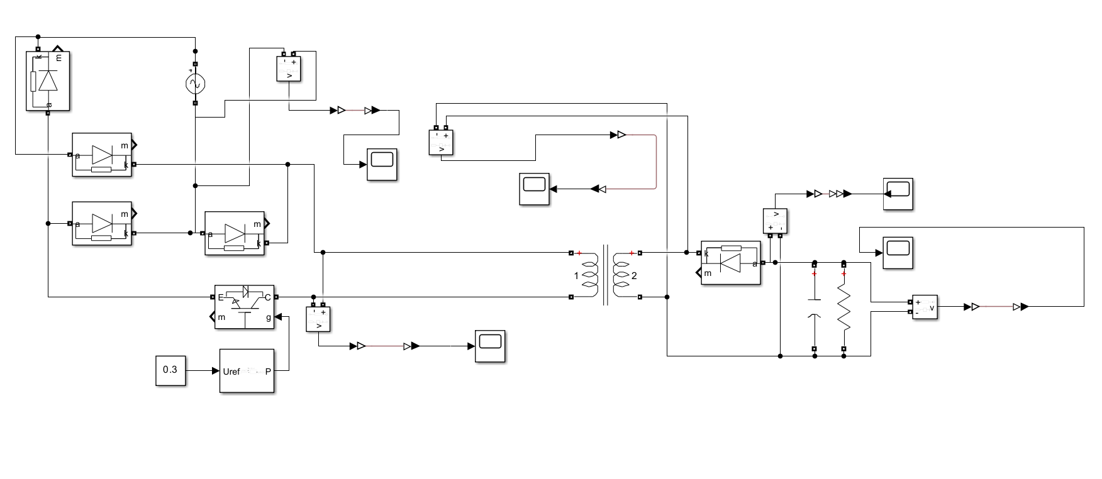
AC Input -> Diode Bridge -> IGBT Switch -> Transformer -> Diode -> RC -> Output

Slide 6
Component Selection
Component | Specification | Part Number | Link
Transformer | Turns ratio: 40:1, Inductance: 34,000 μH. | Custom Designed | N/A
MOSFET | 650V, 10A, RDS(on)=37 mΩ. | IPW60R037P7 | Here
Diode | Reverse voltage: 200V, Forward current: 6A. | GI752-E3/54 | Here
Output Capacitor | 1,000 μF, 10V, Low ESR | EEU-FR1A102LB | Here
Input Capacitor | 470 μF, 400V | MAL219366471E3 | Here
Snubber Resistor | 100 Ω, 2W | PR02000201000JR500 | Here
Snubber Capacitor | 10 nF, 600V | 716P10396JA1 | Here

Slide 7
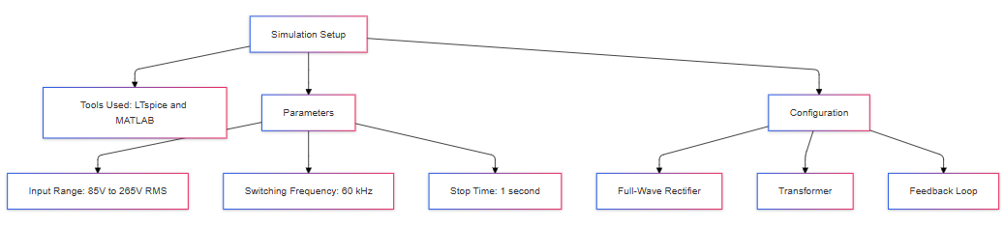
Simulation Setup

Slide 8
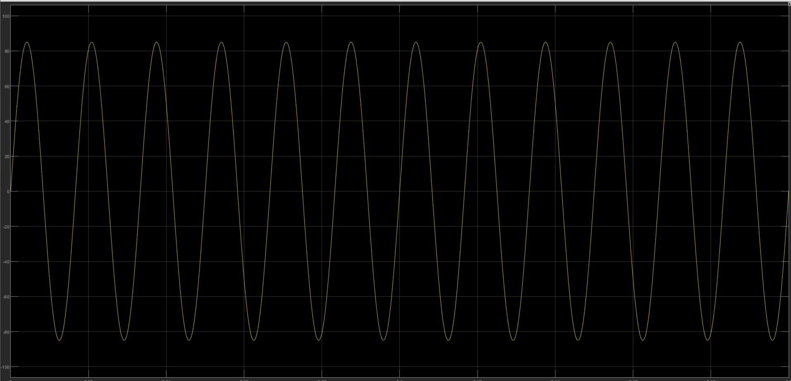
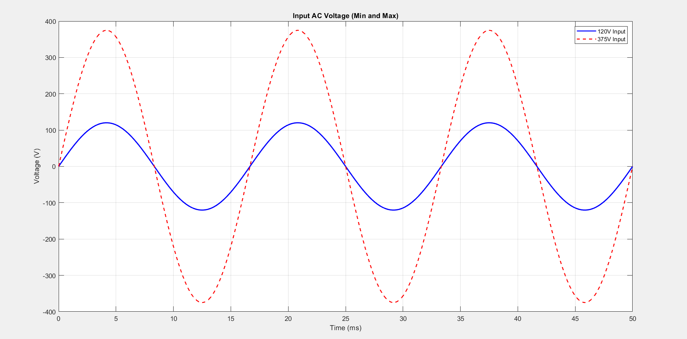
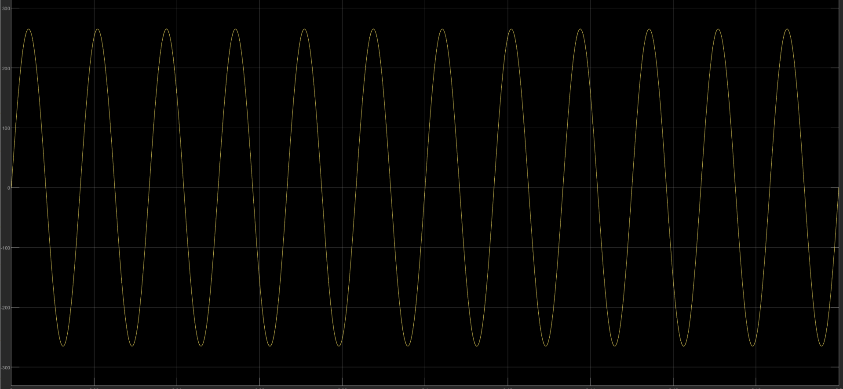
Waveforms
Input Voltage AC

Slide 9
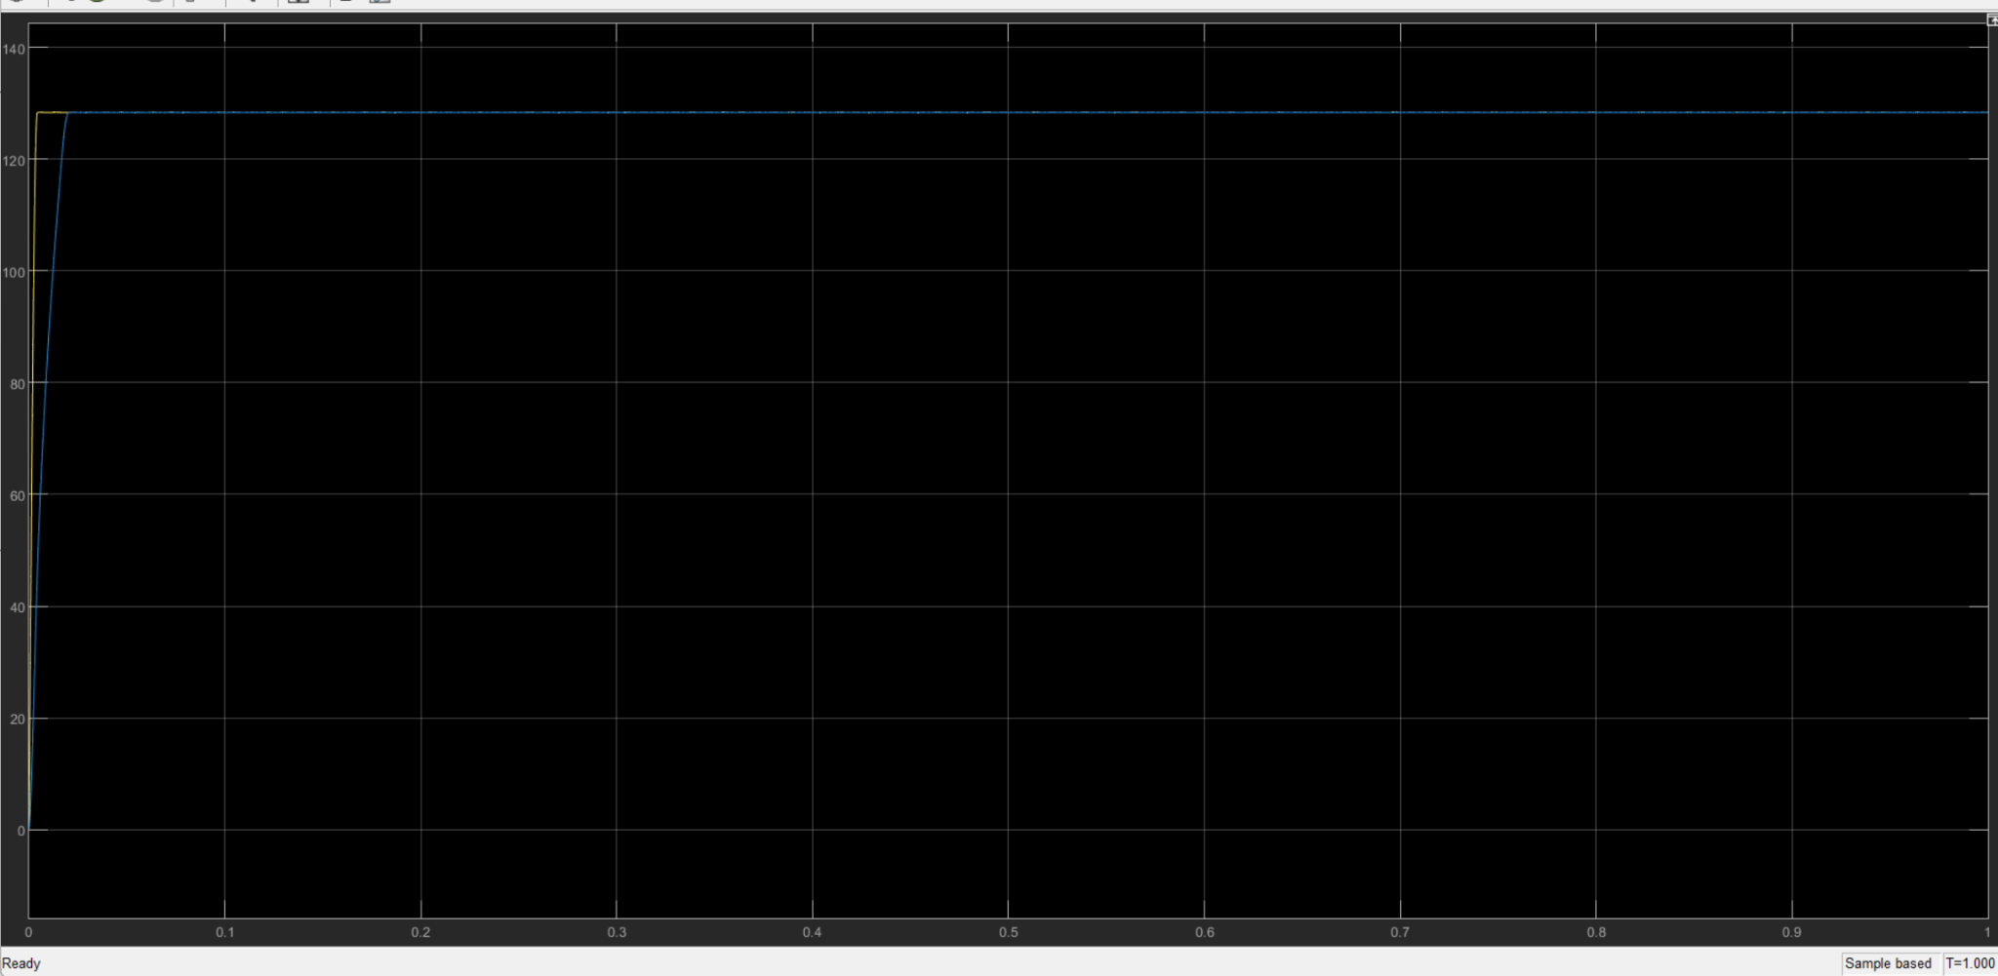
Waveforms
The smoothing capacitor reduces the ripple, creating a steadier DC signal with minor variations. This provides a stable input for the transformer in the next stage.
After diode bridge… Conversion of AC -> DC

Slide 10
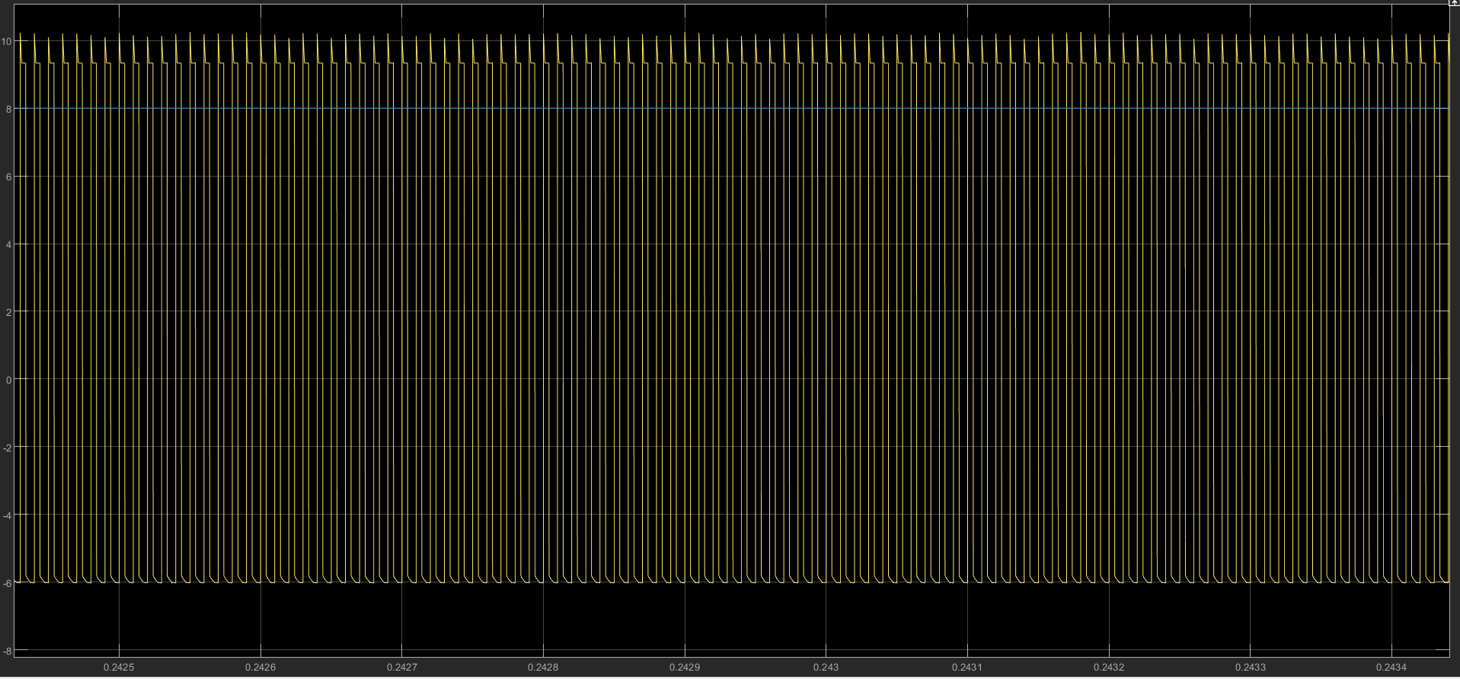
Waveforms
During the MOSFET "on" phase, the transformer stores energy, and during the "off" phase, it transfers this energy to the secondary winding, creating the alternating waveform.
The DC offset arises due to the transformer's operation in Continuous Conduction Mode (CCM), ensuring steady energy transfer and minimizing ripple.
Transformer Secondary Voltage

Slide 11
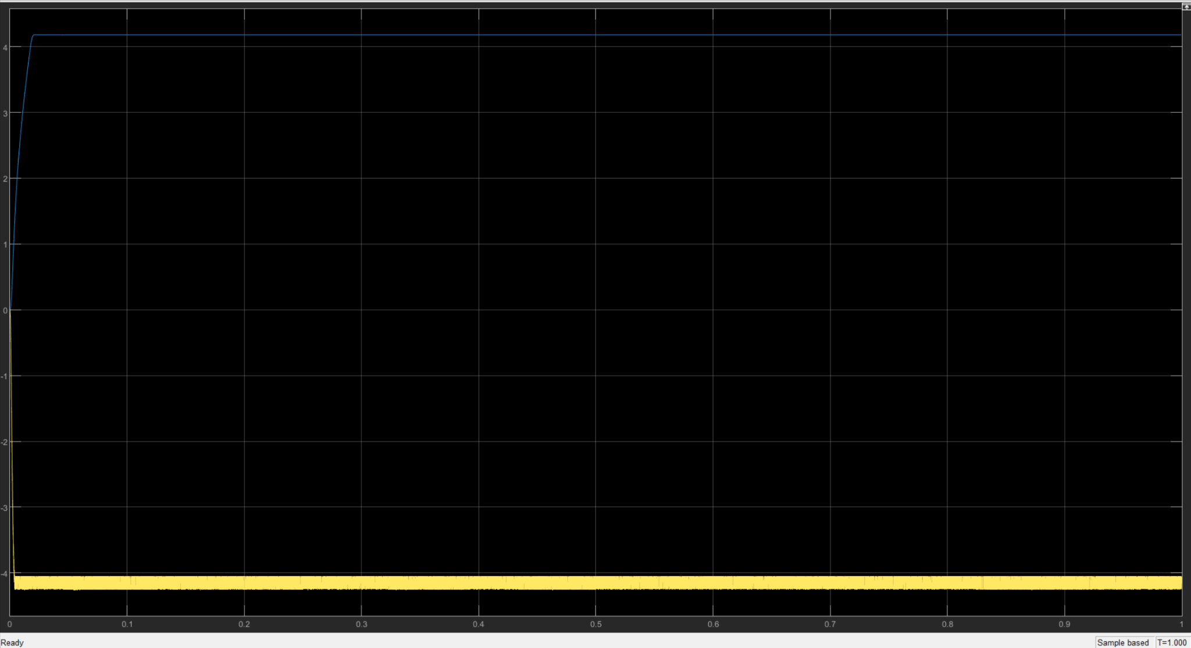
Waveforms
The output waveform is a steady DC signal at 4.79V with a light ripple.
This regulated waveform ensures a consistent output suitable for powering sensitive electronic devices.
Final Output Voltage

Slide 12
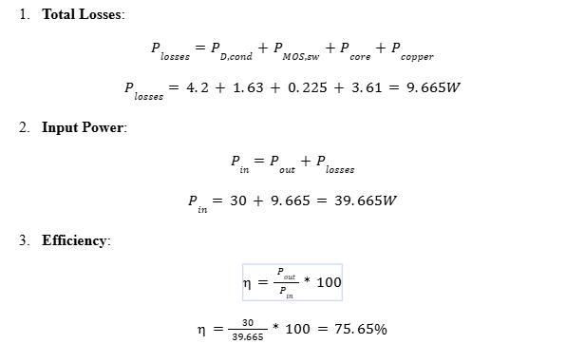
Simulation Results
Waveform Analysis:
Input Voltage: Smooth transition from AC to pulsating DC.
Transformer Secondary Voltage: Accurate step-down based on turns ratio.
Final Output: Regulated almost 5V DC with minimal ripple.
Performance Metrics:
Efficiency: 75.65%.
Effective power conversion according to calculation!

Slide 13
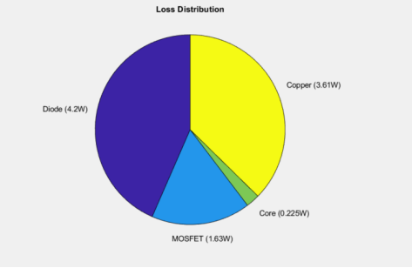
Loss Analysis and Efficiency
Diode Losses (4.2W): Largest contributor due to forward voltage drop.
Copper Losses (3.61W): Significant heat from transformer winding resistance.
MOSFET Losses (1.63W): Moderate due to switching inefficiencies.
Core Losses (0.225W): Minimal, indicating efficient core material.
Total Losses (9.665W): Room for optimization to improve 75.65% efficiency.

Slide 14
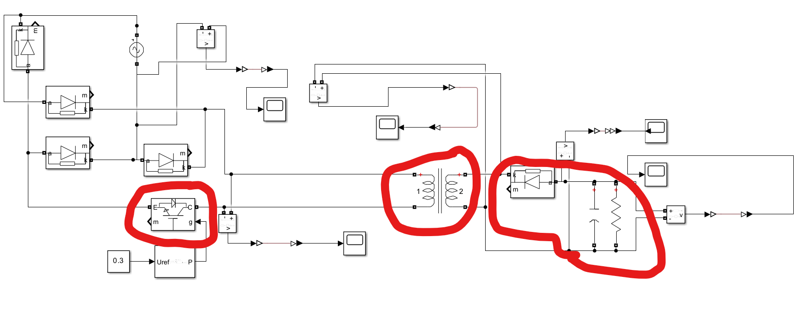
Challenges and Improvements
Challenges:
High switching losses.
Noise and EMI issues.
Tuning feedback control.
Proposed Improvements:
Replace MOSFET with GaN transistors for lower losses and faster switching.
Introduce soft-switching to minimize switching losses and improve efficiency.
Optimize transformer design and implement EMI shielding for better performance.

Slide 15
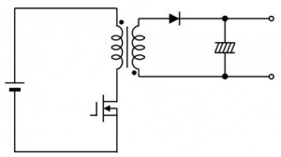
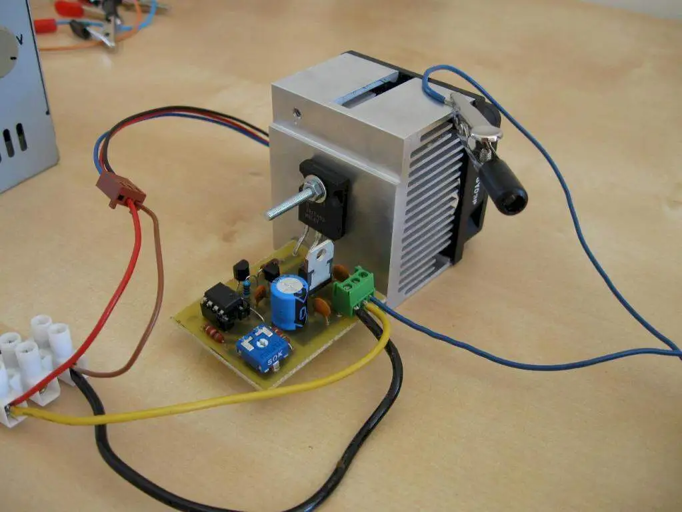
Conclusion
Summary:
Successfully designed and simulated a 5V, 30W isolated power supply.
Achieved galvanic isolation, regulated output, and stable operation.
Next Steps:
Build a hardware prototype to validate design in real-world conditions.
Investigate advanced topologies and methods to further enhance efficiency and reduce losses.

Slide 16
Contributions
Saif: Circuit Design, Graphics, Calculations, Report, Presentation, Research, Tool usage, & Simulation.
Justin: Circuit Design, Calculations, Report, Presentation, Research, Further Improvements, & Simulation

Slide 17
References
[1] Erickson, R. W., & Maksimovic, D. (2007). Fundamentals of power electronics. Springer.
[2] Infineon Technologies. (n.d.). IPW60R037P7 MOSFET datasheet. Retrieved from https://www.mouser.com
[3] KEMET. (n.d.). C330C103KDR5TA capacitor datasheet. Retrieved from https://www.mouser.com
[4] LTspice. (n.d.). LTspice user guide. Analog Devices. Retrieved from https://www.analog.com
[5] Mohan, N., Undeland, T. M., & Robbins, W. P. (2002). Power electronics: Converters, applications, and design. John Wiley & Sons.
[6] Nichicon Corporation. (n.d.). UPW1A102MPD capacitor datasheet. Retrieved from https://www.digikey.com
[7] Panasonic. (n.d.). EEUEB2G471 capacitor datasheet. Retrieved from https://www.mouser.com
[8] Singh, M. D., & Khanchandani, K. B. (2007). Power electronics. Tata McGraw-Hill Education.
[9] Texas Instruments. (n.d.). Flyback converter design guide. Retrieved from https://www.ti.com
[10] Vishay Semiconductor Diodes Division. (n.d.). VS-20ETX06-M3 diode datasheet. Retrieved from https://www.digikey.com
[11] Wurth Elektronik. (n.d.). Transformer design for flyback converters. Retrieved from https://www.we-online.com
[12] Wu, X., & Chen, W. (2016). Resonant and soft-switching converters: Principles, designs, and applications. Wiley-IEEE Press.
[13] Yageo. (n.d.). RS-1002 resistor datasheet. Retrieved from https://www.digikey.com
[14] Digikey Electronics. (n.d.). Component selection and design resources. Retrieved from https://www.digikey.com
[15] Mouser Electronics. (n.d.). Power supply design resources. Retrieved from https://www.mouser.com
[16] MATLAB. (n.d.). Simulink control design. MathWorks. Retrieved from https://www.mathworks.com

